Slide 1
SDNET
CONTEXTUALIZED ATTENTION-BASED DEEP
NETWORK FOR CONVERSATIONAL QUESTION ANSWERING

Slide 2
contents
1 介绍
2 具体实现
3 结果

Slide 3
1 介绍
首先，我们在对话和问题中同时inter-attention and self-attention，更有效地理解文章和对话的历史。
其次，SDNet利用了NLP领域的最新突破性成果：BERT ，我们采用了BERT层输出的加权和，以及锁定的BERT参数。
我们预先准备了前几轮的问题和对当前问题的回答，以纳入上下文信息。

Slide 4
2 具体实现
Integration layer
2
Encoding layer
Output layer
1
3
l

Slide 5
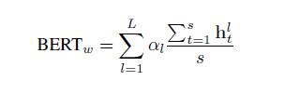
（1） Encoding layer
GloVe embedding g and contextualized embedding for each word in context and question.
contextualized embedding:
use the transformer output from BERT as contextualized embedding
employ a weighted sum of these hidden states to obtain contextualized embedding
is then a per-layer weighted sum of average BERT embedding
Notes:
BERT generates L hidden states for each BPE token

Slide 6
(2) Integration layer
Self-Attention on Question
Multilevel Inter-Attention
2
3
Word-level Inter-Attention
Self Attention on Context.
1
4
ll

Slide 7
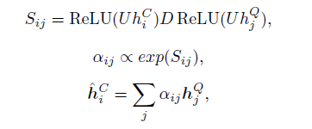





Word-level Inter-Attention
the context word embeddings:
the question word embeddings:
vectors from question to context:
the input vector for context word is
the input vector for each question word is
Notes:
where D is a diagonal matrix and U , k is the attention hidden size.

Slide 8
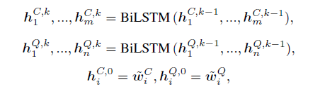

RNN(BiLSTM)
For each question word in Q, we employ one more layer of RNN to generate a higher level of understanding of the question.

Slide 9
Self-Attention on Question
The final question representation：
Notes:
the model needs to directly relate previously mentioned concept with the current question.

Slide 10
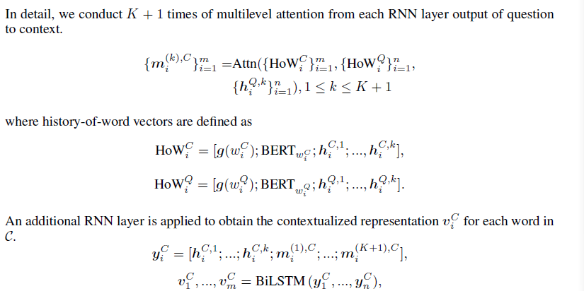
Multilevel Inter-Attention
we use all previous levels to compute attentions scores, but only linearly combine RNN outputs.
Notes:
多层RNN对每个词提取出不同层次的理解后，我们基于各个层次从问题到语境进行多层次的注意表示生成的。

Slide 11


Flow component
is the embedding of the i-th context word in the a-th context；
Notes:
流组件是应用前向RNN将前几轮相同上下文词的信息融合到后几轮

Slide 12
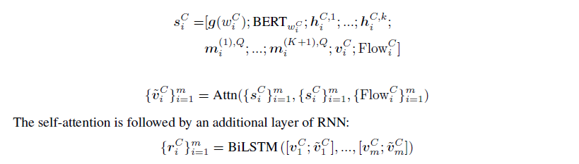

Self Attention on Context
Final Representation of Context：

Slide 13





(3) Output layer
we condense the question representation into one vector:
the answer span start at the i-th word:
the answer span end at the i-th word is:
we minimize the negative log-likelihood function：
Notes:
指出第k个基本事实答案是否为一个段落跨度，“是”、“否”和“未知”。

Slide 14
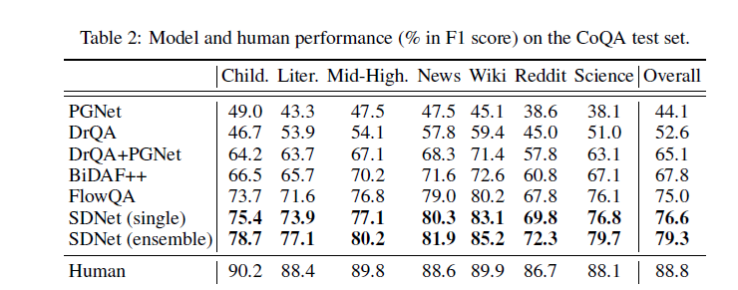
3 结果

Slide 15
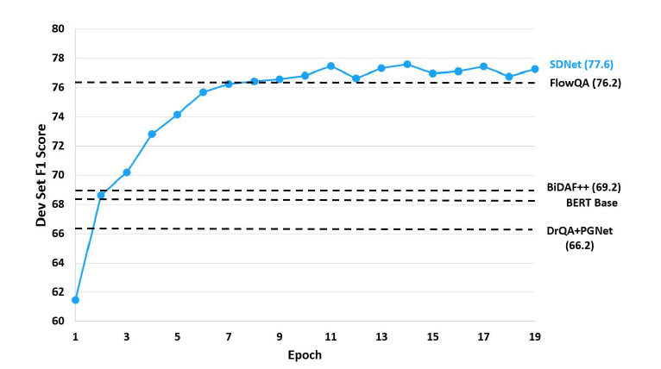
3 结果

Slide 16
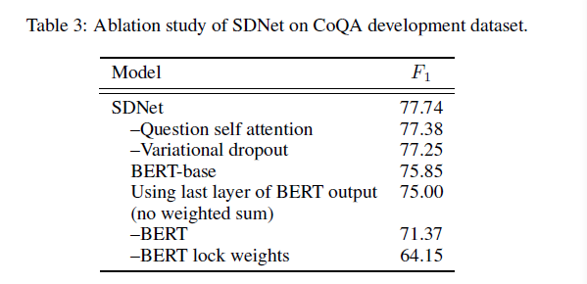
3 结果
Notes:
Using BERT-base instead of BERT-large pretrained model hurts the F1 score by 1.9%

Slide 17
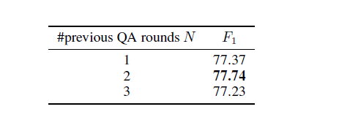
3 结果

Slide 18
THANKS

